Slide 1

CSC/CPE 138 - Computer Network Fundamentals
Transport Layer
The presentation was adapted from the textbook: Computer Networking: A Top-Down Approach 8th edition Jim Kurose, Keith Ross, Pearson, 2020

Slide 2

Chapter 3: roadmap
Transport-layer services
Multiplexing and demultiplexing
Connectionless transport: UDP
Principles of reliable data transfer
Connection-oriented transport: TCP
segment structure
reliable data transfer
flow control
connection management
Principles of congestion control
TCP congestion control

Slide 3
TCP: overview RFCs: 793,1122, 2018, 5681, 7323
point-to-point:
one sender, one receiver
reliable, in-order byte steam:
no “message boundaries"
full duplex data:
bi-directional data flow in same connection
MSS: maximum segment size
cumulative ACKs
pipelining:
TCP congestion and flow control set window size
connection-oriented:
handshaking (exchange of control messages) initializes sender, receiver state before data exchange
flow controlled:
sender will not overwhelm receiver
Notes:
Typical MSS is 1460 bytes

Slide 4
TCP segment structure
32 bits
source port #
dest port #
segment seq #: counting bytes of data into bytestream (not segments!)
ACK: seq # of next expected byte; A bit: this is an ACK
sequence number
acknowledgement number
length (of TCP header)
head
len
not
used
A
P
S
receive window
flow control: # bytes receiver willing to accept
C
E
U
R
F
Internet checksum
checksum
Urg data pointer
options (variable length)
C, E: congestion notification
TCP options
application
data
(variable length)
data sent by application into TCP socket
RST, SYN, FIN: connection management

Slide 5
TCP sequence numbers, ACKs
outgoing segment from sender
Sequence numbers:
byte stream “number” of first byte in segment’s data
source port #
dest port #
sequence number
acknowledgement number
rwnd
checksum
urg pointer
window size
N
Acknowledgements:
seq # of next byte expected from other side
cumulative ACK
sender sequence number space
sent
ACKed
sent, not-yet ACKed
(“in-flight”)
usable
but not
yet sent
not
usable
Q: how receiver handles out-of-order segments
A: TCP spec doesn’t say, - up to implementor
outgoing segment from receiver
source port #
dest port #
sequence number
acknowledgement number
A
rwnd
checksum
urg pointer

Slide 6
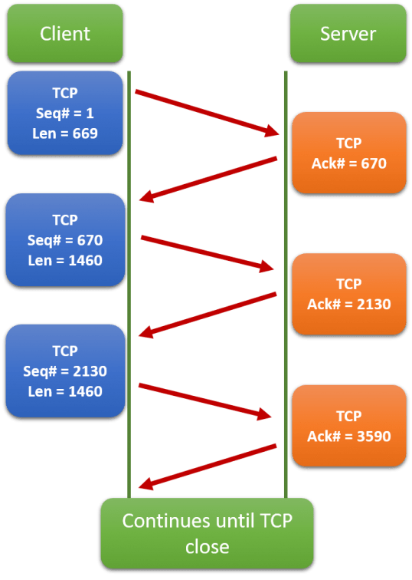
TCP sequence numbers, ACKs
(https://madpackets.com/)

Slide 7
TCP round trip time, timeout
Q: how to set TCP timeout value?
longer than RTT, but RTT varies!
too short: premature timeout, unnecessary retransmissions
too long: slow reaction to segment loss
Q: how to estimate RTT?
SampleRTT:measured time from segment transmission until ACK receipt
ignore retransmissions
SampleRTT will vary, want estimated RTT “smoother”
average several recent measurements, not just current SampleRTT

Slide 8
TCP round trip time, timeout
EstimatedRTT = (1- α)*EstimatedRTT + α*SampleRTT
exponential weighted moving average (EWMA)
influence of past sample decreases exponentially fast
typical value: α = 0.125
RTT: gaia.cs.umass.edu to fantasia.eurecom.fr
RTT (milliseconds)
sampleRTT
EstimatedRTT
time (seconds)
Notes:
This is how TCP re-computes the estimated RTT each time a new SampleRTT is taken.
The process is knows as an exponeitally weighted moving average, shown by the equation here.
<say it>
Where alpha reflects the influence of the most recent measurements on the estimated RTT; a typical value of alpha used in implementaitons is .125
The graph at the bottom show measured RTTs beween a host in the Massachusetts and a host in France, as well as the estimated, “smoothed” RTT

Slide 9

TCP round trip time, timeout
timeout interval: EstimatedRTT plus “safety margin”
large variation in EstimatedRTT: want a larger safety margin
TimeoutInterval = EstimatedRTT + 4*DevRTT
estimated RTT
“safety margin”
DevRTT: EWMA of SampleRTT deviation from EstimatedRTT:
DevRTT = (1-β)*DevRTT + β*|SampleRTT-EstimatedRTT|
(typically, β = 0.25)
Notes:
Given this value of the estimated RTT, TCP computes the timeout interval to be the estimated RTT plus a “safety margin”
And the intuition is that if we are seeing a large variation in SAMPLERTT – the RTT estimates are fluctuating a lot - then we’ll want a larger savety margin
So TCP computes the Timeout interval to be the Estimated RTT plus 4 times a measure of deviation in the RTT.
The deviation in the RTT is computed as the eWMA of the difference between the most recently measured SampleRTT from the Estimated RTT

Slide 10
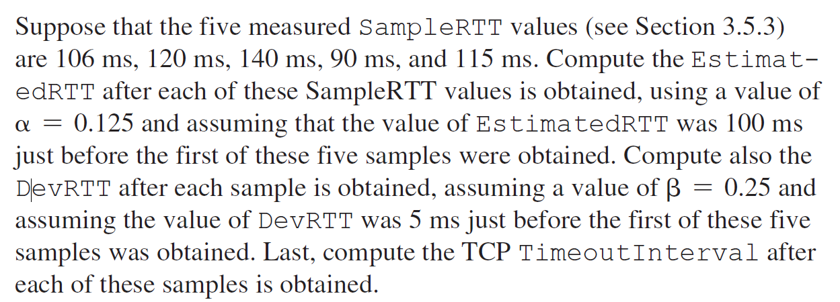
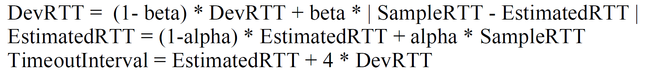
Example
Notes:
After obtaining first SampleRTT 106ms:
DevRTT = 0.75*5 + 0.25 * | 106 - 100 | = 5.25ms
EstimatedRTT = 0.875 * 100 + 0.125 * 106 = 100.75 ms
TimeoutInterval = 100.75+4*5.25 = 121.75 ms
After obtaining 120ms:
DevRTT = 0.75*5.25 + 0.25 * | 120 – 100.75 | = 8.75 ms
EstimatedRTT = 0.875 * 100.75 + 0.125 * 120 = 103.16 ms
TimeoutInterval = 103.16+4*8.75 = 138.16 ms
After obtaining 140ms:
DevRTT = 0.75*8.75 + 0.25 * | 140 – 103.16 | = 15.77 ms
EstimatedRTT = 0.875 * 103.16 + 0.125 * 140 = 107.76 ms
TimeoutInterval = 107.76+4*15.77 = 170.84 ms
After obtaining 90ms:
DevRTT = 0.75*15.77 + 0.25 * | 90 – 107.76 | = 16.27 ms
EstimatedRTT = 0.875 * 107.76 + 0.125 * 90 = 105.54 ms
TimeoutInterval = 105.54+4*16.27 =170.62 ms
After obtaining 115ms:
DevRTT = 0.75*16.27 + 0.25 * | 115 – 105.54 | = 14.57 ms
EstimatedRTT = 0.875 * 105.54 + 0.125 * 115 = 106.72 ms
TimeoutInterval = 106.72+4*14.57 =165 ms

Slide 11
TCP Sender (simplified)
event: data received from application
create segment with seq #
seq # is byte-stream number of first data byte in segment
start timer if not already running
think of timer as for oldest unACKed segment
expiration interval: TimeOutInterval
event: timeout
retransmit segment that caused timeout
restart timer
event: ACK received
if ACK acknowledges previously unACKed segments
update what is known to be ACKed
start timer if there are still unACKed segments
Notes:
Given these details of TCP sequence numbers, acks, and timers, we can now describe the big picture view of how the TCP sender and receiver operate
You can check out FSMs in book; let’s just give an English text description here and let’s start with the sender.

Slide 12
TCP Receiver: ACK generation [RFC 5681]
Event at receiver
arrival of in-order segment with
expected seq #. All data up to
expected seq # already ACKed
arrival of in-order segment with
expected seq #. One other
segment has ACK pending
arrival of out-of-order segment
higher-than-expect seq. # .
Gap detected
arrival of segment that
partially or completely fills gap
TCP receiver action
delayed ACK. Wait up to 500ms
for next segment. If no next segment,
send ACK
immediately send single cumulative
ACK, ACKing both in-order segments
immediately send duplicate ACK,
indicating seq. # of next expected byte
immediate send ACK, provided that
segment starts at lower end of gap
Notes:
Rather than immediately ACKnowledig this segment, many TCP implementations will wait for half a second for another in-order segment to arrive, and then generate a single cumulative ACK for both segments – thus decreasing the amount of ACK traffic. The arrival of this second in-order segment and the cumulative ACK generation that covers both segments is the second row in this table.

Slide 13

TCP: retransmission scenarios
Host A
Host B
Host A
Host B
SendBase=92
Seq=92, 8 bytes of data
Seq=92, 8 bytes of data
timeout
timeout
Seq=100, 20 bytes of data
ACK=100
X
ACK=100
ACK=120
Seq=92, 8 bytes of data
Seq=92, 8
bytes of data
SendBase=100
send cumulative
ACK for 120
SendBase=120
ACK=100
ACK=120
SendBase=120
lost ACK scenario
premature timeout
Notes:
To cement our understanding of TCP reliability, let’s look a a few retransmission scenarios
In the first case a TCP segments is transmited and the ACK is lost, and the TCP timeout mechanism results in another copy of being transmitted and then re-ACKed a the sender
In the second example two segments are sent and acknowledged, but there is a premature timeout e for the first segment, which is retransmitted. Notet that when this retransmitted segment is received, the receiver has already received the first two segments, and so resends a cumulative ACK for both segments received so far, rather than an ACK for just this fist segment.

Slide 14
TCP: retransmission scenarios
Host A
Host B
Seq=92, 8 bytes of data
Seq=100, 20 bytes of data
ACK=100
X
ACK=120
Seq=120, 15 bytes of data
cumulative ACK covers for earlier lost ACK
Notes:
And in this last example, two segments are again transmitted, the first ACK is lost but the second ACK, a cumulative ACK arrives at the sender, which then can transmit a third segment, knowing that the first two have arrived, even though the ACK for the first segment was lost

Slide 15

TCP fast retransmit
Host A
Host B
TCP fast retransmit
if sender receives 3 additional ACKs for same data (“triple duplicate ACKs”), resend unACKed segment with smallest seq #
likely that unACKed segment lost, so don’t wait for timeout
Seq=92, 8 bytes of data
Seq=100, 20 bytes of data
X
ACK=100
timeout
ACK=100
ACK=100
Receipt of three duplicate ACKs indicates 3 segments received after a missing segment – lost segment is likely. So retransmit!
ACK=100
Seq=100, 20 bytes of data
Notes:
Let’s wrap up our study of TCP reliability by discussing an optimization to the original TCP known as TCP fast retransmit,
Take a look at this example on the right where 5 segments are transmitted and the second segment is lost. In this case the TCP receiver sends an ACK 100 acknowledging the first received segment.
When the third segment arrives at the receiver, the TCP receiver sends another ACK 100 since the second segment has not arrived. And similarly for the 4th and 5th segments to arrive.
Now what does the sender see? The sender receives the first ACK 100 it has been hoping for, but then three additional duplicate ACK100s arrive. The sender knows that somethings’ wrong – it knows the first segment arrived at the receiver but three later arriving segments at the receiver – the ones that generated the three duplicate ACKs – we received correctly but were not in order. That is, that there was a missing segment at the receiver when each of the three duplicate ACK were generated.
With fast retransmit, the arrival of three duplicate ACK causes the sender to retransmit its oldest unACKed segment, without waiting for a timeout event. This allows TCP to recover more quickly from what is very likely a loss event
specifically that the second segment has been lost, since three higher -numbered segments were received

